Slide 1
Delightful To God
Matthew 6:1-18
The Sermon On The Mount
Notes:
Read Matt. 6:1-6 before advancing slides

Slide 2
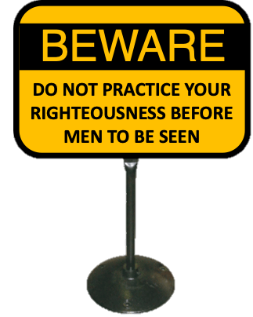
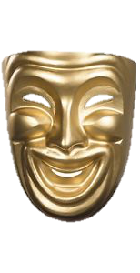
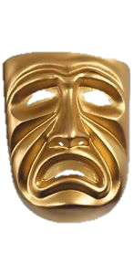
HYPOCRITE—one who puts on a mask and feigns himself to be what he is not; a dissembler in religion.
Easton’s Bible Dictionary

Slide 3

Where Is Sin Most Likely To Happen?
Where Will You Be A Hypocrite?
Notes:
Act in a manner that is inconsistent with your heart whether good or bad.
1 Corinthians 4:5 (NASB)
⁵ Therefore do not go on passing judgment before the time, but wait until the Lord comes who will both bring to light the things hidden in the darkness and disclose the motives of men’s hearts; and then each man’s praise will come to him from God.
Hebrews 4:12–13 (NASB)
¹² For the word of God is living and active and sharper than any two-edged sword, and piercing as far as the division of soul and spirit, of both joints and marrow, and able to judge the thoughts and intentions of the heart. ¹³ And there is no creature hidden from His sight, but all things are open and laid bare to the eyes of Him with whom we have to do.

Slide 4
ATTENTION:
I am going to give a generous gift to a poor person
Matthew 6:2
“So when you give to the poor, do not sound a trumpet before you, as the hypocrites do in the synagogues and in the streets, so that they may be honored by men. Truly I say to you, they have their reward in full.

Slide 5


Matthew 6:1-8,14-18
Notes:
They don’t care if God hears their prayer as long as people applaud their efforts.
Paid in full Matt. 6:2, 5, 16
Rewarded By God Matt. 6:4, 6, 18

Slide 6
Why give to the poor?
Because you want to help them out
Why should I pray?
Because I need God to hear me
Why should I forgive?
Because I need God to forgive me
Why should I fast?
I want God to see my dedication or
notice my plea for His intervention
Notes:
This gets at the motivation behind the actions and the heart of the matter.
It doesn’t matter if men see you or not if you are sincere
If you are sincere you will also be practicing righteousness in public and in secret

Slide 7
Why should I study the bible?
To learn about God & To better serve God
Why should I sing?
To praise God & To encourage others
Leave a contribution?
To honor God from my wealth
Why should I serve my brother?
To demonstrate my love for him
Notes:
Proverbs 3:5–6 (NASB)
⁵ Trust in the Lord with all your heart And do not lean on your own understanding. ⁶ In all your ways acknowledge Him, And He will make your paths straight.
Colossians 3:16 (NASB)
¹⁶ Let the word of Christ richly dwell within you, with all wisdom teaching and admonishing one another with psalms and hymns and spiritual songs, singing with thankfulness in your hearts to God.
Ephesians 5:18–20 (NASB)
¹⁸ And do not get drunk with wine, for that is dissipation, but be filled with the Spirit, ¹⁹ speaking to one another in psalms and hymns and spiritual songs, singing and making melody with your heart to the Lord; ²⁰ always giving thanks for all things in the name of our Lord Jesus Christ to God, even the Father;
2 Corinthians 9:6–7 (NASB)
⁶ Now this I say, he who sows sparingly will also reap sparingly, and he who sows bountifully will also reap bountifully. ⁷ Each one must do just as he has purposed in his heart, not grudgingly or under compulsion, for God loves a cheerful giver.
Proverbs 3:9–10 (NASB)
⁹ Honor the Lord from your wealth And from the first of all your produce; ¹⁰ So your barns will be filled with plenty And your vats will overflow with new wine.
John 13:34–35 (NASB)
³⁴ “A new commandment I give to you, that you love one another, even as I have loved you, that you also love one another. ³⁵ “By this all men will know that you are My disciples, if you have love for one another.”

Slide 8
The Lord’s Prayer
Vs. 9 God is in the highest
place in creation and in our hearts
Vs. 10 God’s rule and will are far superior
to the ways of the world or my mind
Vs. 11 (therefore) I need God to sustain my life (physical and spiritual)
Vs. 12 I need God to forgive my debts
Vs. 13 I need God’s guidance and salvation
Notes:
Theme Verses of the Sermon – 5:21, 6:9, 24, 33

Slide 9

Romans 12:1
Therefore I urge you, brethren, by the mercies of God, to present your bodies a living and holy sacrifice, acceptable to God, which is your spiritual service of worship.

Slide 10
Romans 12:2
And do not be conformed to this world, but be transformed by the renewing of your mind, so that you may prove what the will of God is, that which is good and acceptable and perfect.

Slide 11
1 Timothy 1:5
But the goal of our instruction is love from a pure heart and a good conscience and a sincere faith.

