Slide 1
Devoted To God
Matthew 6:19-34

Slide 2
Rewards
Matthew 6
Man – 2, 5, 16 paid in full
God – 1, 4, 6, 18 God will reward

Slide 3
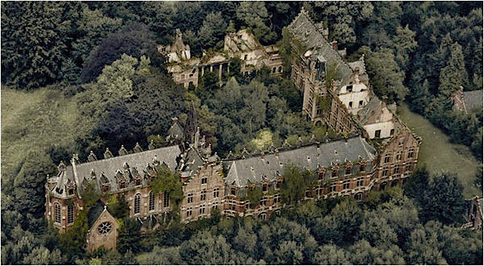

Slide 4
Matthew 6:19
“Do not store up for yourselves treasures on earth, where moth and rust destroy, and where thieves break in and steal.

Slide 5
Matthew 6:20
“But store up for yourselves treasures in heaven, where neither moth nor rust destroys, and where thieves do not break in or steal;
John 10:10 Life Abundant
John 3:16 Eternal Life
Mark 8:36-37 Most Valuable Treasure
Notes:
Tree is the oldest living single organism on earth. Named Methuselah the tree is 4849 in this picture

Slide 6
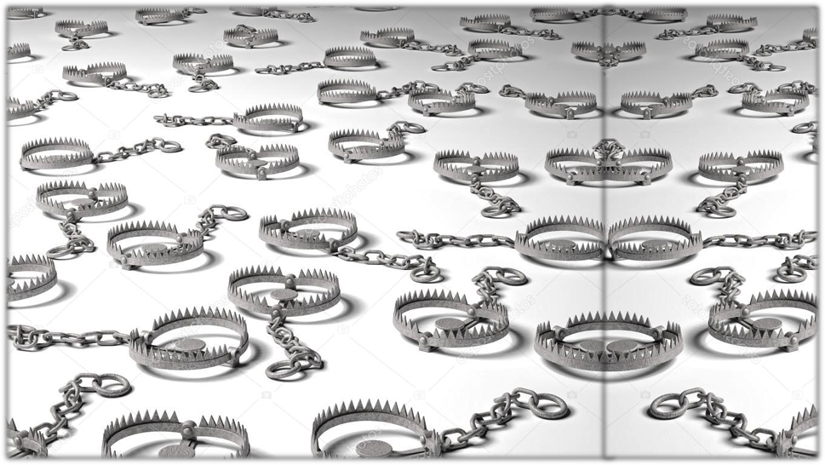
Notes:
John 3:19-21 Men love the darkness because their deeds are evil
John 3:19–21 (NASB)
19 “This is the judgment, that the Light has come into the world, and men loved the darkness rather than the Light, for their deeds were evil.
20 “For everyone who does evil hates the Light, and does not come to the Light for fear that his deeds will be exposed.
21 “But he who practices the truth comes to the Light, so that his deeds may be manifested as having been wrought in God.”

Slide 7
Matthew 6:24
“No one can serve two masters; for either he will hate the one and love the other, or he will be devoted to one and despise the other. You cannot serve God and wealth.

Slide 8
For This Reason…
Where your treasure is there your heart will be also
If your eye is bad your whole body will be full of dark
You cannot serve God and wealth
Matthew 6:25

Slide 9
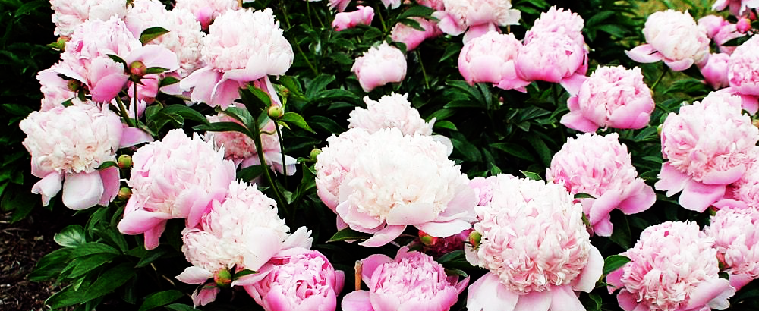
Matthew 6:25
25 “For this reason I say to you, do not be worried about your life, as to what you will eat or what you will drink; nor for your body, as to what you will put on. Is not life more than food, and the body more than clothing?

Slide 10
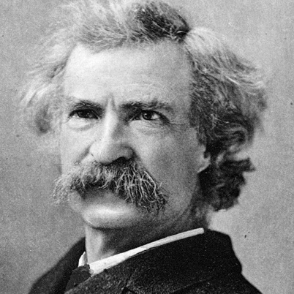
”I am an old man and have known a great many troubles, most of which never happened.” ― Mark Twain

Slide 12
Devoted To God
Matthew 6:19-34

