Slide 1
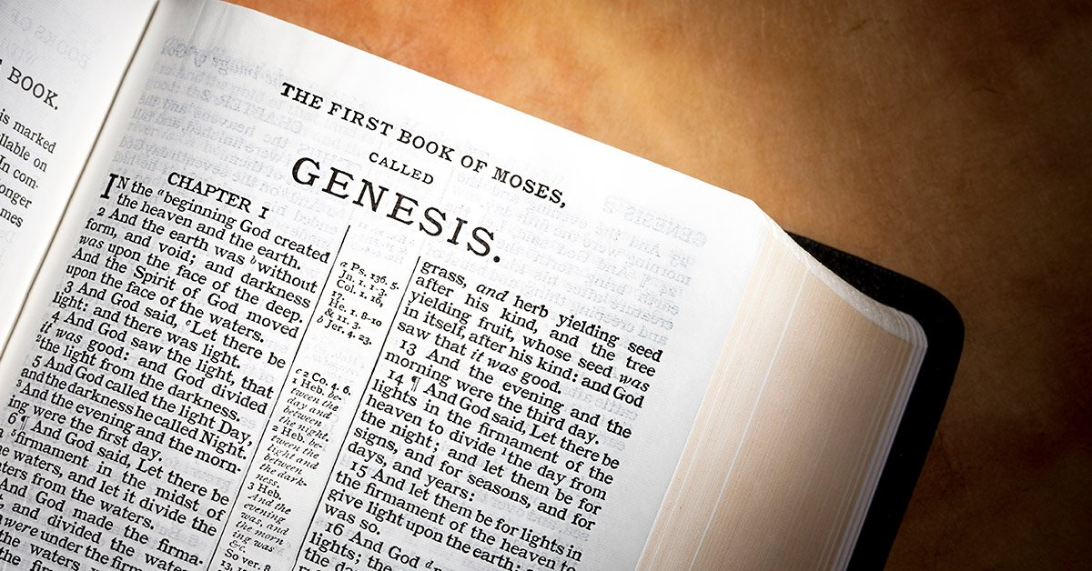

Slide 2
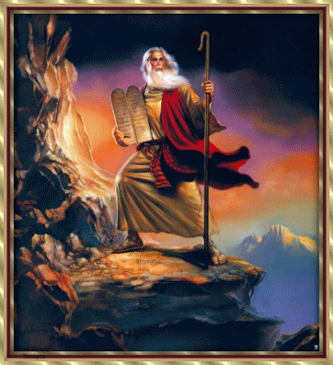
The Book Of Moses
Luke 24:44 Moses, Prophets, & Psalms
John 7:22 Circumcision
John 1:1-3 Jesus was the creator
Mark 10:5-9 Two become one flesh
The prophecy found in Genesis can be attributed to Moses as the author of the book.

Slide 3
Gen. 1:1-4:16 – 4:17-5:ff – Creation and fall of man
Gen 6:1-9:ff – 10:1-ff Days of Noah and the flood
Gen 11:1-9 – 11:10-30 Tower of Babel, Families become nations
Gen 12:1-25:6 – 25:7-18 Life of Abraham to the marriage of Isaac
Gen 25:19-35:22a – 35:22b-36:ff Life of Isaac, Jacob to the birth of Benjamin
Gen 37:1-46:7 – 46:8-46:27 Sons of Israel with focus on Joseph
Gen 46:28-50:26 – Exodus 1:1-7 Israel and family come into Egypt

Slide 4
1. Creation (1:1–2:3)
2. Ṭôleḏôṯ of the heavens and the earth (2:4–4:26)
3. Ṭôleḏôṯ of Adam (5:1–6:8)
4. Ṭôleḏôṯ of Noah (6:9–9:29)
5. Ṭôleḏôṯ of Shem, Ham, and Japheth (10:1–11:9)
6. Ṭôleḏôṯ of Shem (11:10–26)
7. Ṭôleḏôṯ of Terah (11:27–25:11)
8. Ṭôleḏôṯ of Ishmael (25:12–18)
9. Ṭôleḏôṯ of Isaac (25:19–35:29)
10. Ṭôleḏôṯ of Esau (36:1–8)
11. Ṭôleḏôṯ of Esau, father of the Edomites (36:9–37:1)
12. Ṭôleḏôṯ of Jacob (37:2–50:26)
Ross, A. P. (1985). Genesis. In J. F. Walvoord & R. B. Zuck (Eds.), The Bible Knowledge Commentary: An Exposition of the Scriptures (Vol. 1, p. 22). Wheaton, IL: Victor Books.

Slide 5
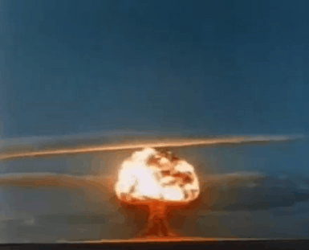
Oversimplified Timeline of Earth
Genesis 1:1

Slide 6
Before Creation
God is Eternal Psalm 90:1-2 God is from everlasting to everlasting Isaiah 44:6 I am the first and the last there is no other God
Jesus was with God John 1:1-3 In the beginning with God – Creator John 17:5, 24 Jesus before the foundation of world Rev. 1:17-18, 21:6-7, 22:13 I am the First & Last Alpha & Omega, Beginning & End
Notes:
Psalms 90:1-2
Lord, You have been our dwelling place in all generations.
2 Before the mountains were born Or You gave birth to the earth and the world, Even from everlasting to everlasting, You are God.
Isaiah 44:6
“Thus says the Lord, the King of Israel and his Redeemer, the Lord of hosts: ‘I am the first and I am the last, And there is no God besides Me.

Slide 7
Before Creation
Planning Before Creation 2 Tim 1:9 Granted in Jesus from all eternity
Eph. 1:4-5 Chose us before the foundation of the world
Titus 1:2 Promised before the ages began ESV
Rom. 16:25 Kept secret since the world began KJV
Phil. 2:6-7 Although in the form of God emptied Himself taking the form of a servant
Notes:
Psalms 90:1-2
Lord, You have been our dwelling place in all generations.
2 Before the mountains were born Or You gave birth to the earth and the world, Even from everlasting to everlasting, You are God.
Isaiah 44:6
“Thus says the Lord, the King of Israel and his Redeemer, the Lord of hosts: ‘I am the first and I am the last, And there is no God besides Me.

Slide 8
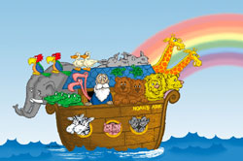
Before Christ
Gen. 3:15
Abraham Gen. 12:3
Jacob Gen. 25:23
Judah Gen 49:10
Isaac Gen 17:19
David 1 Sam. 7:12
Prophets (Acts 3:19-26)
Notes:
Issac – 26:4 seed promis
Jacob 28:14 Seed promise
Geneology of Jesus Mt. 1:1, Luke 3:23 To record this timeline
Jews would have been aware that the scripture was written before Jesus

Slide 9
What do we learn from the book of Genesis?

Slide 10
What do we learn from the book of Genesis?

Slide 11
What do we learn from the book of Genesis?

Slide 12
What do we learn from the book of Genesis?

