Slide 1


Slide 2




Name three things that distinguish man from animals?

Slide 3

Genesis 2:8
The LORD God planted a garden toward the east, in Eden; and there He placed the man whom He had formed.
Why did God…
Make Man
Give Man a garden
Purpose Man to cultivate
Give Man dominion
Give a command of warning
Create Man a companion
Give a command of blessing
Genesis 2:15
Then the Lord God took the man and put him into the garden of Eden to cultivate it and keep it.

Slide 4

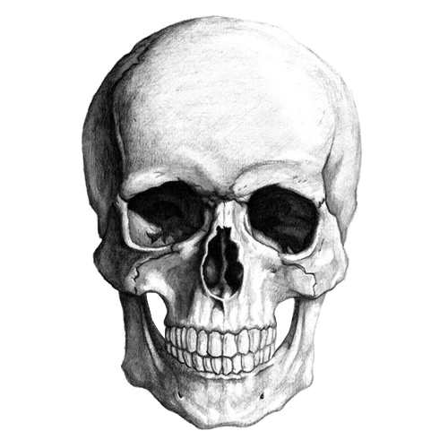
Genesis 2:16–17
The Lord God commanded the man, saying, “From any tree of the garden you may eat freely; but from the tree of the knowledge of good and evil you shall not eat, for in the day that you eat from it you will surely die.”

Slide 5
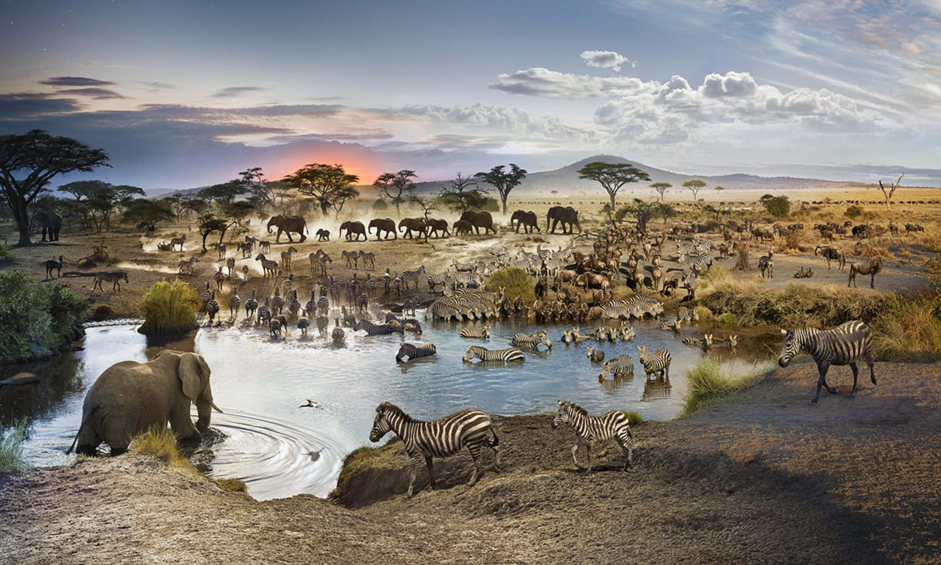
Genesis 2:20
The man gave names to all the cattle, and to the birds of the sky, and to every beast of the field, but for Adam there was not found a helper suitable for him.
Hebrews 10:4; 10-14
Ephesians 5:25-32
Notes:
Animal flesh was not suitable but bone of my bone flesh of my flesh was suitable
Animals were not a sufficient sacrifice
Jesus blood is what makes up a suitable bride. – Linked to this part of Genesis as part of the reasoning for making the church suitable

Slide 6
God & Adam have a relationship
Notes:
The relationship between God and man is greater than all other relationships and is given precedent in the creation narrative (history)

Slide 7

Genesis 2:23
The man said, “This is now bone of my bones, And flesh of my flesh; She shall be called Woman, Because she was taken out of Man.”
(Ishshah)
(Ish)
Notes:
It is not the institution of the Nap

Slide 8
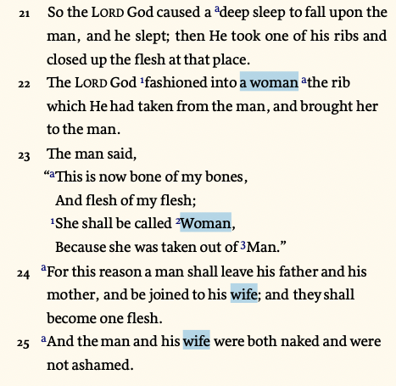
Biblical Marriage
“One man one woman for life”
Notes:
Matthew 19:1-9 one man one woman for life – Moses gave the exception for adultery.
Can a man divorce his wife for any reason at all? NO
Why did Moses say give a certificate of divorce? Due to adultery
Deut. 24:1-4 Did Moses allow remarriage after adultery
Shouldn’t they be stoned?
Deut. 22:22
Deut. 17:6 on the testimony of two or three witnesses they shall be put to death

Slide 9
Biblical Marriage
“One man one woman for life”
Notes:
Matthew 19:1-9 one man one woman for life – Moses gave the exception for adultery.
Can a man divorce his wife for any reason at all? NO
Why did Moses say give a certificate of divorce? Due to adultery
Deut. 24:1-4 Did Moses allow remarriage after adultery
Shouldn’t they be stoned?
Deut. 22:22
Deut. 17:6 on the testimony of two or three witnesses they shall be put to death

Slide 10
Biblical Marriage
“One man one woman for life”
Notes:
Matthew 19:1-9 one man one woman for life – Moses gave the exception for adultery.
Can a man divorce his wife for any reason at all? NO
Why did Moses say give a certificate of divorce? Due to adultery
Deut. 24:1-4 Did Moses allow remarriage after adultery
Shouldn’t they be stoned?
Deut. 22:22
Deut. 17:6 on the testimony of two or three witnesses they shall be put to death

Slide 11
Biblical Marriage
“One man one woman for life”
Notes:
Matthew 19:1-9 one man one woman for life – Moses gave the exception for adultery.
Can a man divorce his wife for any reason at all? NO
Why did Moses say give a certificate of divorce? Due to adultery
Deut. 24:1-4 Did Moses allow remarriage after adultery
Shouldn’t they be stoned?
Deut. 22:22
Deut. 17:6 on the testimony of two or three witnesses they shall be put to death

