Slide 2
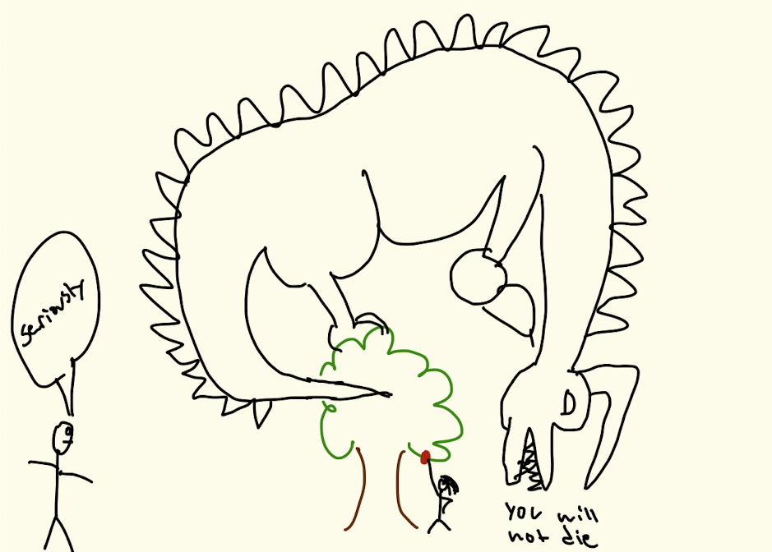
Genesis 3:1-5
1-3 Why is Adam given credit for being the forerunner of sin? 1 Corinthians 15:22, Romans 5:14
4-5 In what way did Satan lie & murder? John 8:44
Did they die?
Were their eyes opened?
Did they become like God?
6-7 The woman saw… delight to eyes 1 John 2:16

Slide 3
Genesis 3:6-13
Ashamed Conceal Hide Afraid Blame Self protect Deceit
Their eyes were opened - Isaiah 6:8-10

